Slide 1
Finding the best neighborhood for a vegan restaurant in Curitiba, Brazil

Slide 2
The problem
My client desires to open a vegan restaurant in Curitiba, Brazil, a large city with 75 neighborhoods
The result should be the ONE neighborhood to do so
He is going to invest a large amount of money opening the restaurant, so there’s no place for mistakes

Slide 3
Available Data
A list of Curitiba’s neighborhoods with its geographic coordinates
The Foursquare database, with information regarding the most popular venues in the city

Slide 4
Characteristics to be found in a target neighborhood
A neighborhood full of restaurants
A neighborhood where people go out to eat
Non vegan people could be attracted
Low
A neighborhood with some vegan identity
Higher probability of having vegan people walking around
A Farmers Market is a popular venue among people who have a plant based diet, so it became the second venue filter

Slide 5
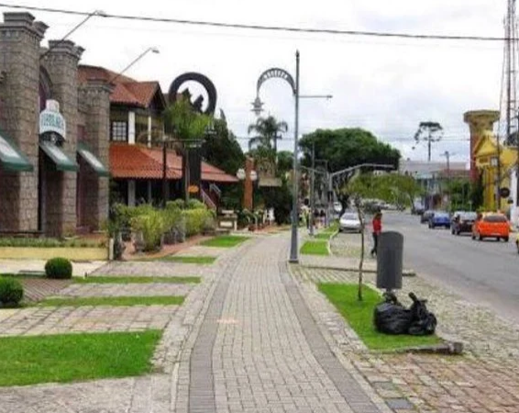
The result
Filtering neighborhoods and venues, I have found Santa Felicidade (Portuguese for “Holy Happiness”), a neighborhood full of restaurants and farmers markets.

